Slide 1
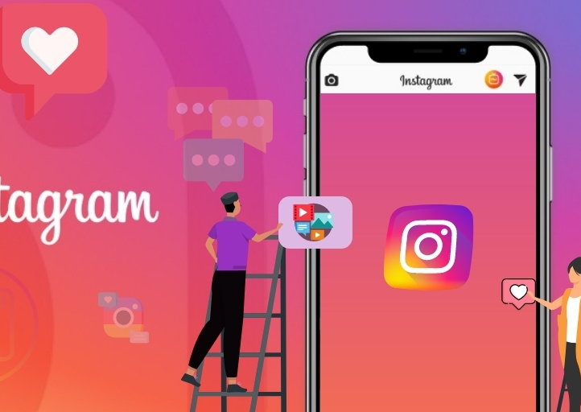
Instagram Reach Analysis
Group 6
Team Members : Ankita Urade (1002175173) Pratiksha Patil (1002131066) Shaik Sameera Farheen (1002159541) Sravya kanthuri (1002177935) Sushma Ayenampudi (1002165564)

Slide 2

1.Introduction
Content
Data Description and Source
3.Research Questions
4. Methodologies

Slide 3

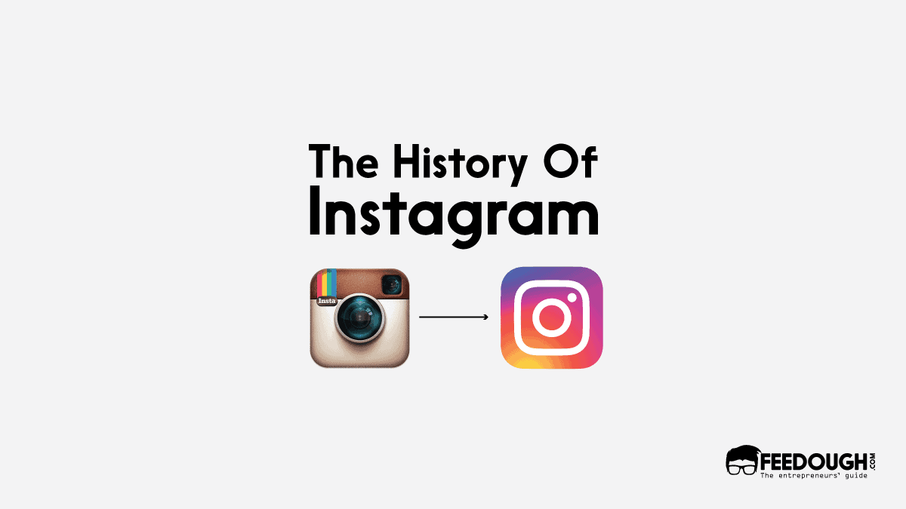

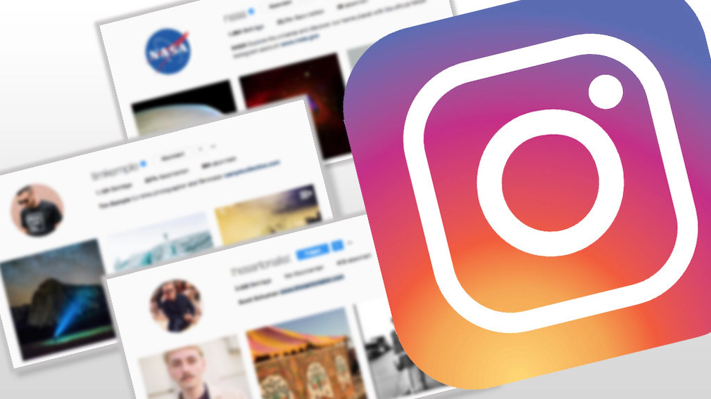
Instagram Overview
HISTORY & HOW IT WORKS
Launched in 2010, Instagram has become a popular social media platform for sharing photos and videos, known for its user-friendly interface and emphasis on visual content. Founded by Kevin Systrom and Mike Krieger, the platform was acquired by Facebook in 2012, propelling its growth into one of the world's most widely used social networks, boasting over a billion active users today. Instagram allows users to share photos and videos, enhancing them with hashtags, filters, and location tags. Its algorithms curate personalized feeds, fostering engagement through likes, comments, and direct messages.
Significance of Analyzing Instagram Data
Analyzing Instagram data is essential for content creators as it provides insights into audience demographics, content performance, and engagement trends. By understanding their audience and optimizing content strategy accordingly, creators can increase engagement, improve content quality, and make informed decisions for future campaigns.

Slide 4


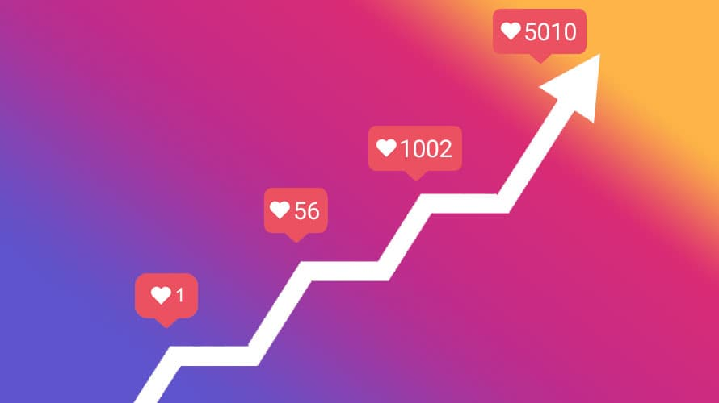
Significance of Analyzing Instagram Data
Analyzing Instagram data is essential for both content creators and businesses alike, as it provides valuable insights into audience demographics, content performance, and engagement trends. By understanding their audience and optimizing content strategy accordingly, creators can increase engagement, improve content quality, and make informed decisions for future campaigns. Moreover, businesses can leverage these insights to refine their marketing strategies, connect with their target audience more effectively, and ultimately achieve their marketing objectives on the platform.
Significance of Analyzing Instagram Data
History and How it works?
Launched in 2010, Instagram has become a popular social media platform for sharing photos and videos, known for its user-friendly interface and emphasis on visual content.
Analyzing Instagram data is essential for content creators as it provides insights into audience demographics, content performance, and engagement trends. By understanding their audience and optimizing content strategy accordingly, creators can increase engagement, improve content quality, and make informed decisions for future campaigns.

Slide 5



DataSource and Variables
03
Data Description
The dataset covers a content creator’s Instagram activity over the last six months, including metrics such as Impressions, Reach from Home feed, Reach from Hashtags, Reach from Explore, Reach from other sources, Saves, Comments, Shares, Likes, Profile Visits, Follows, Captions, and Hashtags employed.
01
DataSource
Statso.io
https://statso.io/wp-content/uplo ads/2022/10/archive.zip
02
No of Variables
13

Slide 6

List of variables:
Impressions: The total number of times the content was displayed to users on Instagram.
Reach from Home feed: The number of unique users who saw the content in their home feed.
Reach from Hashtags: The number of unique users who saw the content through hashtags.
Reach from Explore: The number of unique users who discovered the content through the Explore page.
Reach from other sources: The number of unique users who saw the content from sources other than the home feed, hashtags, or Explore.
History and How it works?
Significance of Analyzing Instagram Data
Saves: The number of times users saved the content to view later.
Comments: The number of comments left on the content.
Shares: The number of times users shared the content with others.
Likes: The number of likes received on the content.
Profile Visits: The number of times users visited the creator's profile after viewing the content.
Launched in 2010, Instagram has become a popular social media platform for sharing photos and videos, known for its user-friendly interface and emphasis on visual content.
Analyzing Instagram data is essential for content creators as it provides insights into audience demographics, content performance, and engagement trends. By understanding their audience and optimizing content strategy accordingly, creators can increase engagement, improve content quality, and make informed decisions for future campaigns.
Follows: The number of users who started following the creator after viewing the content.
Captions: The text accompanying the content.
Hashtags employed: The hashtags used in the content to categorize and increase its visibility.

Slide 7
Research Questions
Predictive
Descriptive
What are the key factors driving the reach and engagement of our Instagram content?
How do the various reach metrics (impressions, profile visits, likes, comments, shares) on Instagram posts correlate with each other, and what patterns or relationships can we identify to better understand audience behavior and optimize our content strategy?
How accurately can our trained model predict the reach of new or future Instagram posts?
Predict the reach(Impression) of future Instagram posts based on certain approximations.

Slide 8
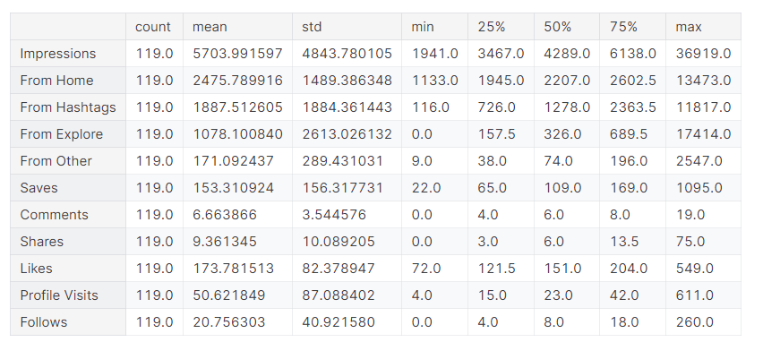
Exploratory Data Analysis
Missing Value check - df.isna().sum()
Statistical Profile of Dataset Attributes -
df.describe().transpose()

Slide 9
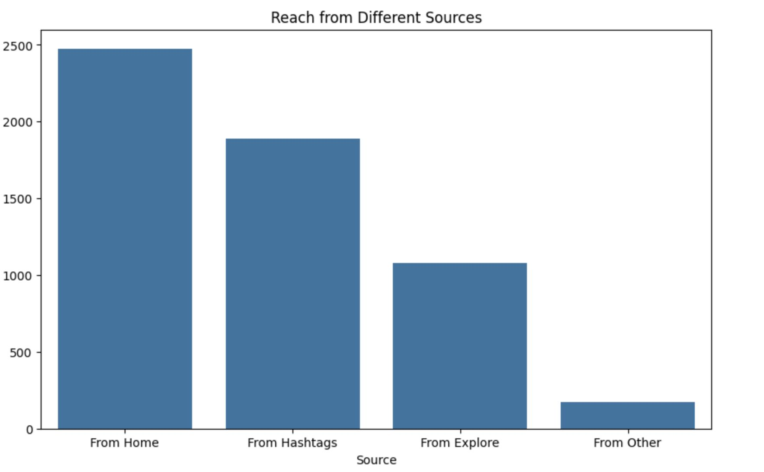
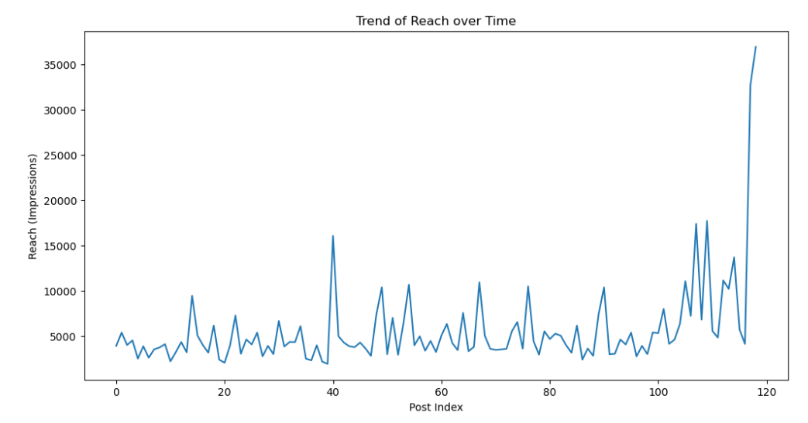
Exploring Insights: Bar Charts and Plots

Slide 10
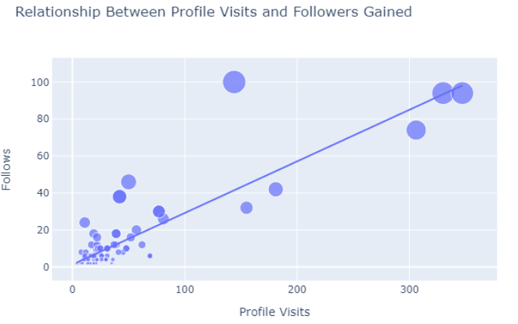
A Profile’s Conversion rate and Engagement rate
conversion_rate = (df.["Follows"].sum() / df.["Profile Visits"].sum()) * 100)
Engagement rate = ((df['Likes'] + df['Comments'] + df["Shares"]) / df['Impressions']) * 100

Slide 11
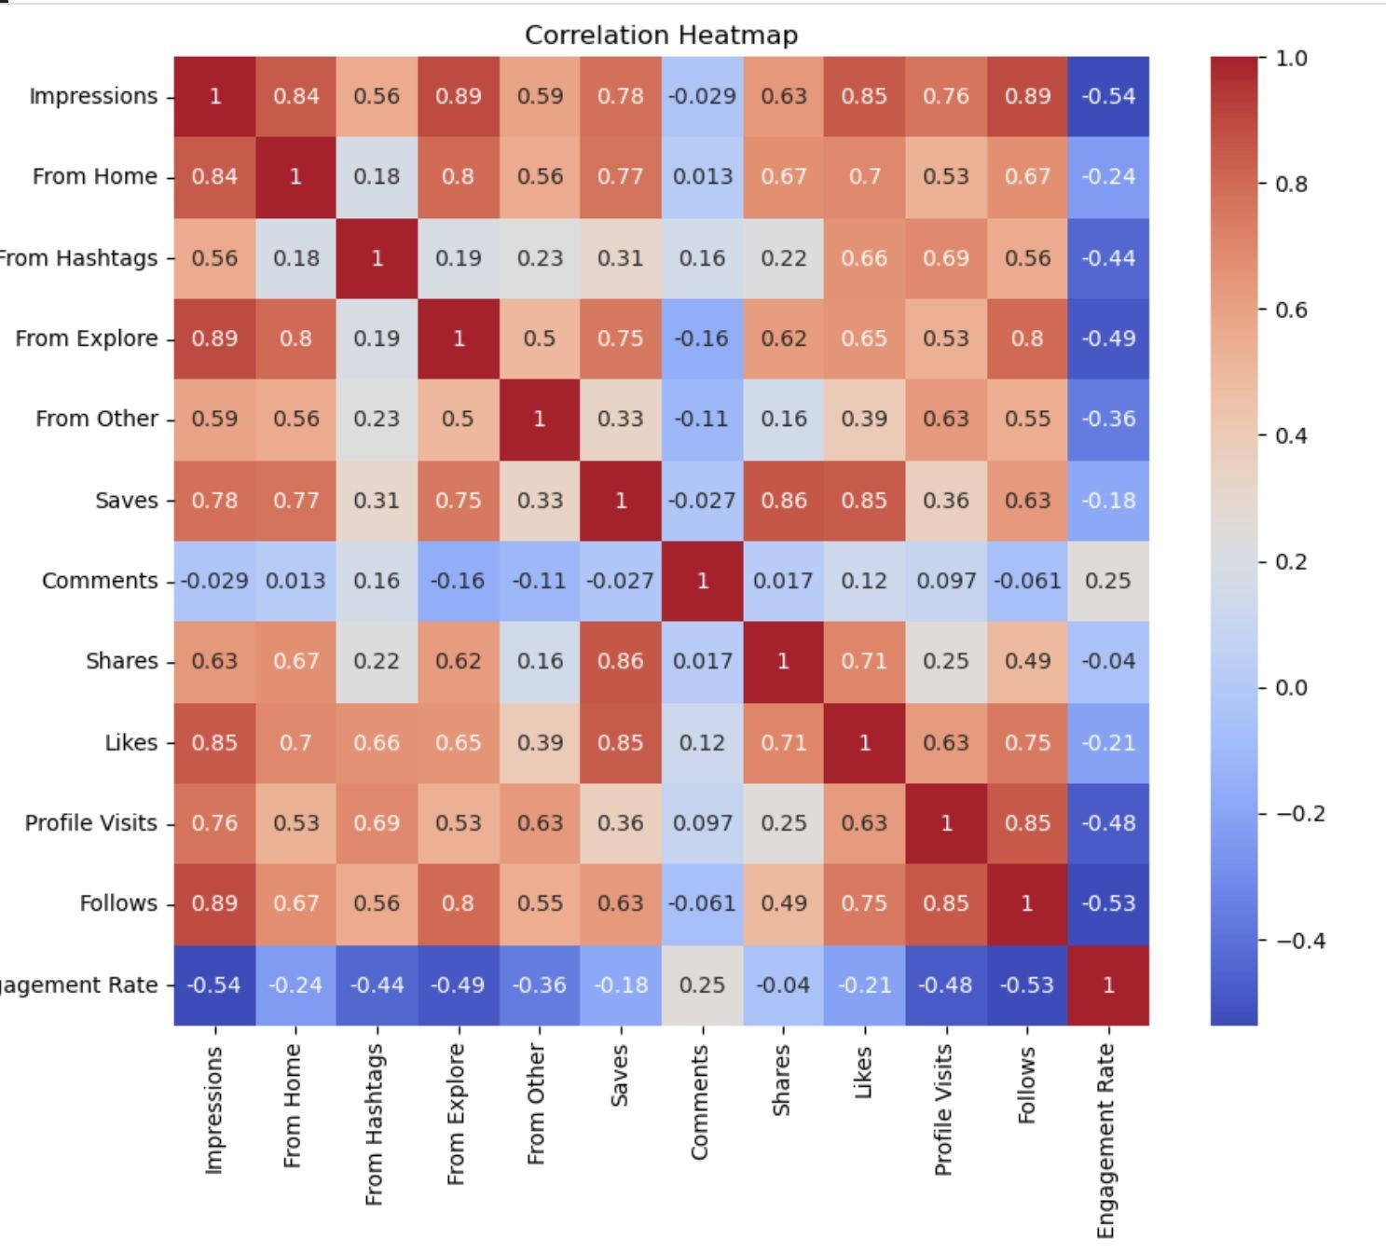
Correlation
Analysis

Slide 12
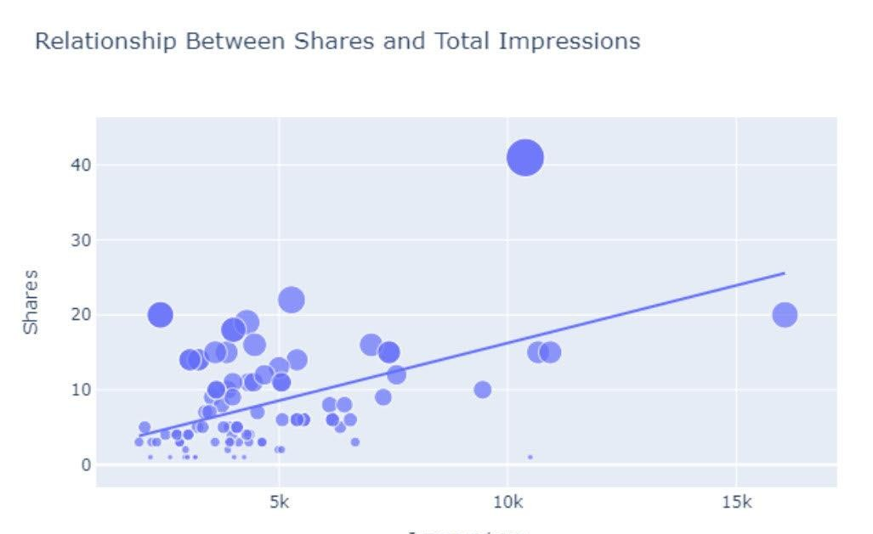
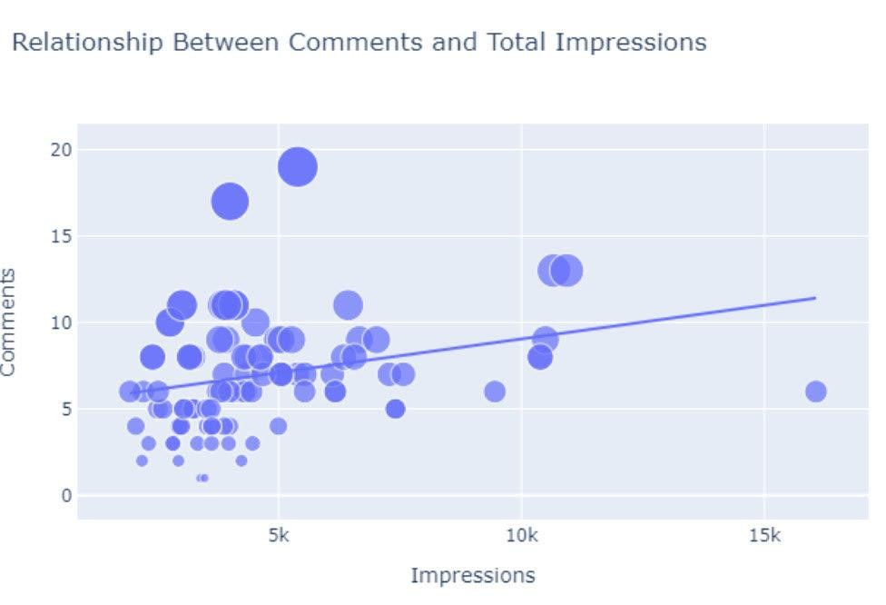
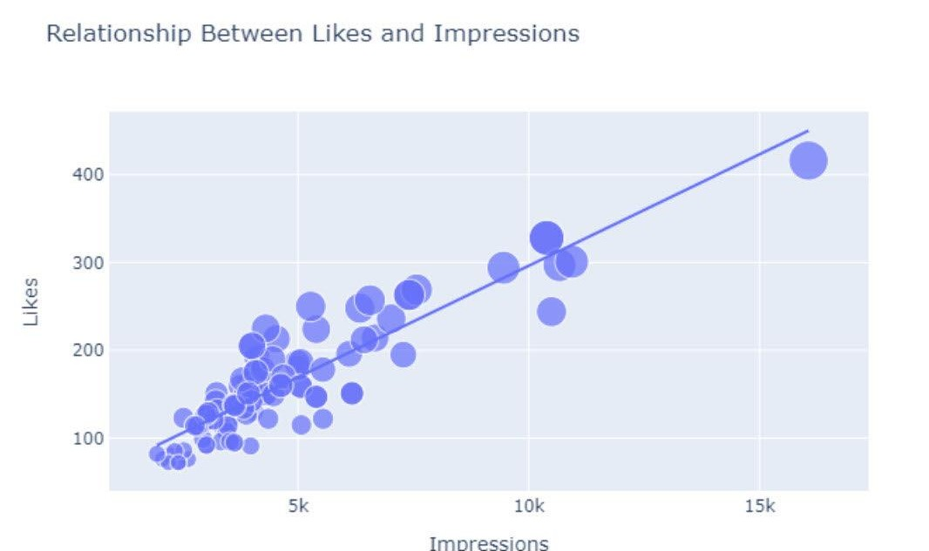
Fit a linear regression line to the scatter plot using the OLS method.

Slide 13
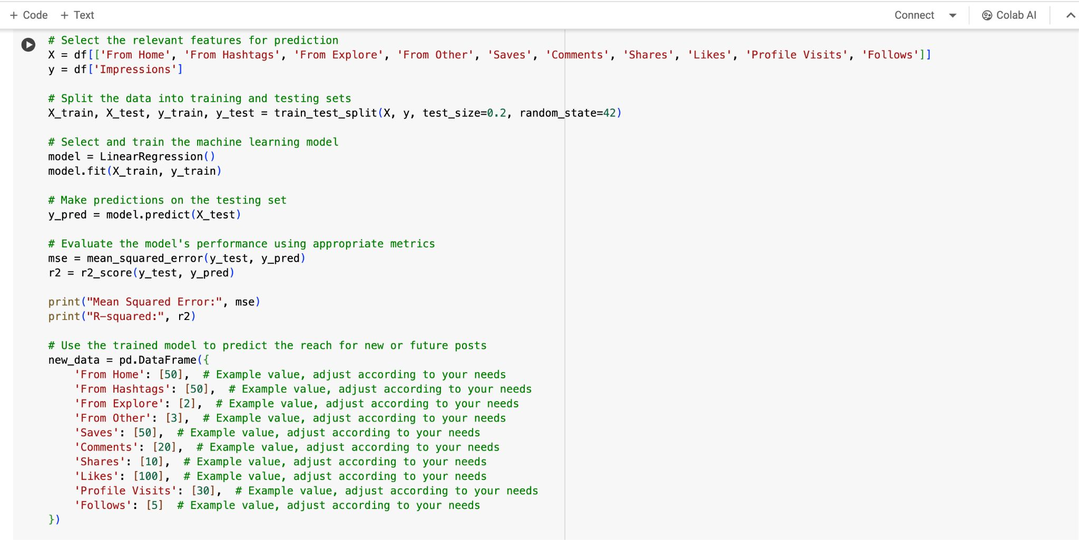
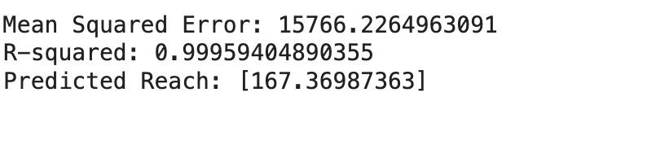
Predictive Analysis:
Predictive Analysis:

Slide 14

Recommendations :
Content Strategy
Hashtags and Captions
Engagement
Analytics and monitoring

Slide 15

Thank You

